Slide 2
Agenda Day 2 second hour
Conditional statements
Use of Boolean operators
Shorthand notations if, elif, else
Ternary operators
Loops
For
While
Useful statements
Break, continue, pass
Program development

Slide 3
Conditional Statements

Slide 4
Logical operators from mathematics
EQUALS
a == b
NOT EQUALS
a != b
LESS THAN
a < b
LESS THAN OR EQUALS
a <= b
GREATER THAN
a > b
GREATER THAN

Slide 5

Use case: Sort the boxes
Suppose we have some boxes of different colors and weights
We want to identify and sort these boxes.

Slide 6
Use of logical conditions
The logical operators can be used in several ways
Most commonly they are used in conditional statements and loops.
Examples: In English
If color of a box is red AND weight of box is greater than 10kg
Then Do something…….
If (color of box is blue OR weight of box is less than 50kg) AND (color of box is red OR weight of box is less than-equals to 10kg)
Then Do something

Slide 7
Use of logical conditions
If color of a box is red AND weight of box is less than-equal to 10kg
Then do something…
Else if color of a box is blue AND weight of box is greater than 10kg
Then do something…
Else
Then do something…

Slide 8
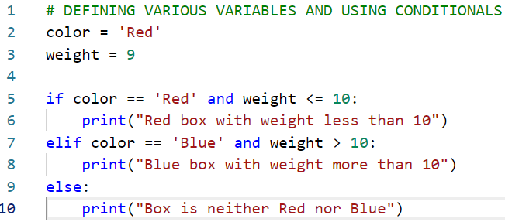
Logical conditionals in Python
In the code we are defining two variables color and weight.
Both have been assigned some values (lines 2-3).
Conditional statements have been used in lines 5-10.

Slide 9
Observations from the code
O1: We can observe that python works on indentations (no use of brackets) after if, elif and else statements.
O2: The logical operators used inside if and elif are returning Boolean (true or false) values.
O3: logical “and” actually creates a very strict condition
O3.1: Suppose we assign color value as Red but weight is assigned as 11
Then the if and elif conditions will not be executed.
Only else condition will be true in this scenario.

Slide 10
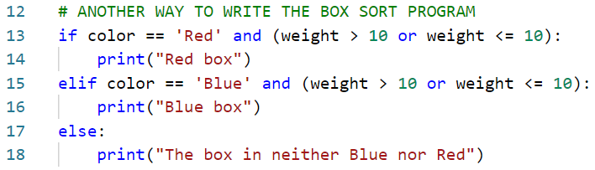
Another way to write the conditional statements
We can use the logical “or” operator.
Therefore, the if condition is true even though we entered weight greater than 10

Slide 11
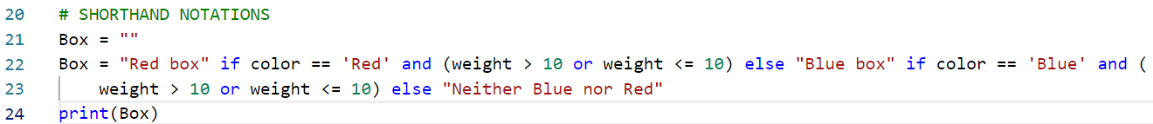
Shorthand notations for conditionals
The if, elif, else conditional statements written on the previous page can be rewritten in the following shorthand notation.
Also called as Ternary operators or conditional expressions
The main advantage of using the Ternary operator is that all the logic is written as a single line of code.
Better code manageability, maintainability and readability (though it is subjective)

Slide 12
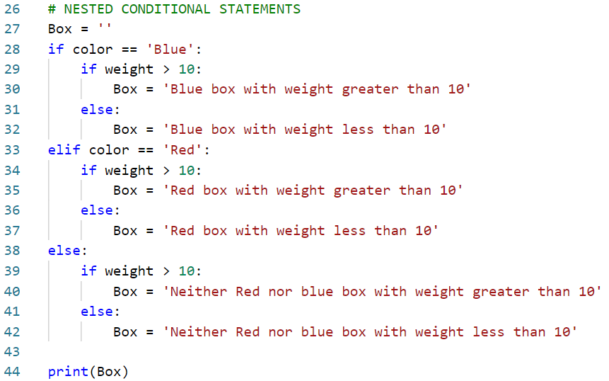
Nested conditional statements
The code in lines 27-44 demonstrates the use of nested conditional statements.
If……Else conditional statements can be embedded inside if…elif…else statements.
The code can be further enhanced by using “Ternary operators”

Slide 13
Exercise 1
The nested conditional statements shown in the previous slide can be represented by using the “Ternary operators”
Enhance the code shown in the previous slide and demonstrate the use of “Ternary operator”

Slide 14
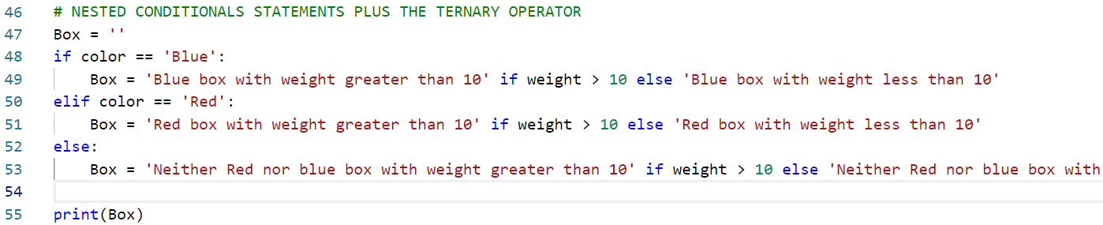
Solution 1

Slide 15
Loops

Slide 16
Loops in Python
Why do we need a loop:
Let us suppose that we want to repeat something for couple of times.
In plain English
While using loops we are telling the computer to keep doing something until some conditions are not met.
A loop is used to iterate over a sequence
A list, a dictionary, a set, a tuple or a string
We can execute a set of statements once for each item in the sequence.

Slide 17
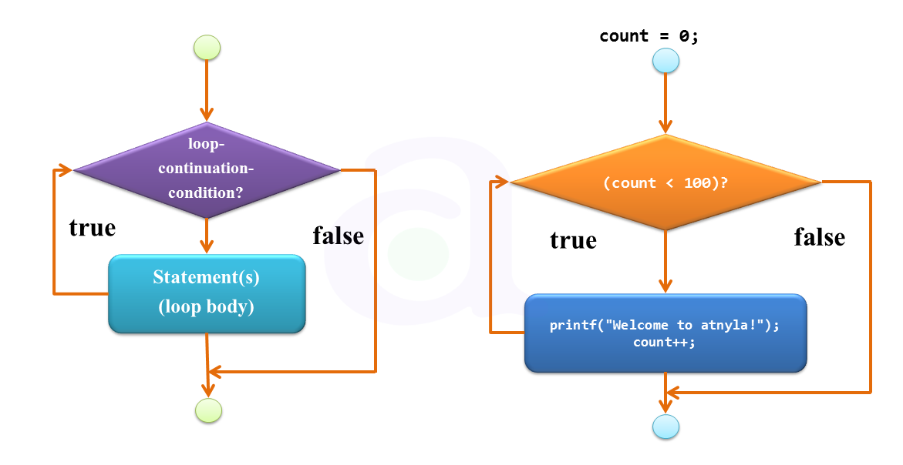
Loop examples

Slide 18
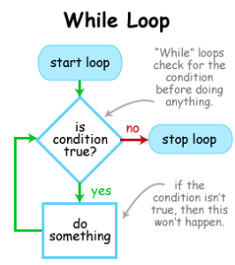
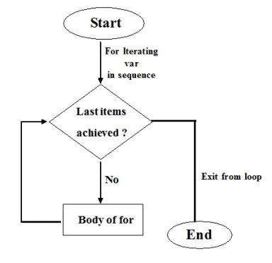
Loop examples
For Loop

Slide 19
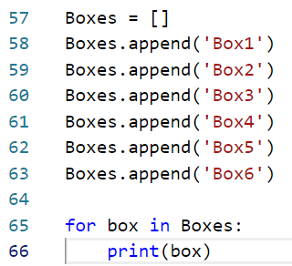
FOR LOOP
Less like a for loop in programming languages like C, C++ but
More like an iterator method found in other Object Oriented Programming languages.
The for loop in python does not require an indexing variable beforehand.
As shown in the example we are iterating over a list containing boxes.
No indexing variable is required like other languages e.g. for(int i =0; i <= 10; i++ ){}

Slide 20
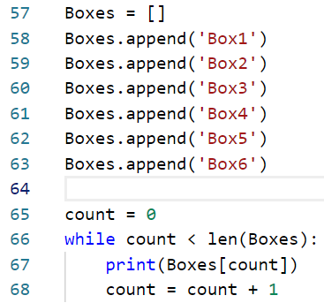
WHILE LOOP
While loop can be used to execute a set of statements as long as a conditional statement is true.
The while loop requires relevant variables to be ready.
In the code shown we need a count variable
The variable is initialized before the loop
The conditional statement is used to check if the count variable’s value is less than the size if the list i.e. len(Boxes)
The count variable is incremented in each iteration

Slide 21
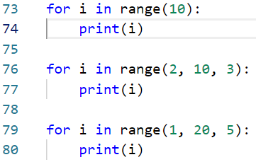
Useful statements in a For loop
Range
To loop through a code specified number of time we can use the range function.
Range function returns a sequence of numbers, starting from 0 by default and increments by 1.
However it is possible to specify a starting index and increment sequence

Slide 22
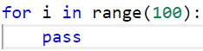
Useful statements in a For loop
For loops cannot be empty, but if for some reason we have a for loop with no content,
We can use the pass statement to avoid getting an error

Slide 23
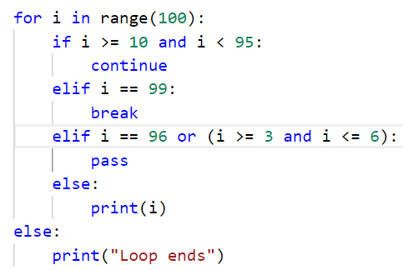
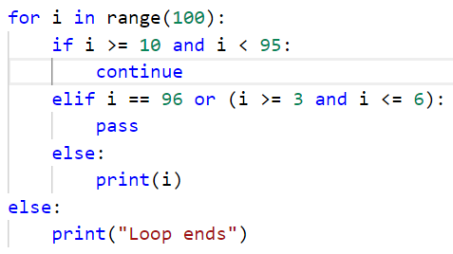
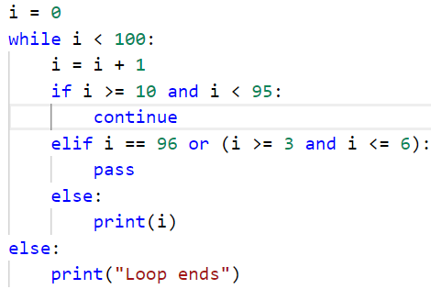
Some other useful statements
Break
The break statement is used to stop the loop even if conditional statement is true
Continue
The continue statement is used to stop the current iteration of the loop and continue with the next one
Else
Specifies a block of code that is executed when the loop is finished, else statement will not work in presence of a break statement

Slide 24
Program development

Slide 25
Sorting the Boxes: Program
We now want to design a program that can be used for sorting the boxes.
System design and requirements
We require a data structure for holding all the boxes.
We require a mechanism to iterate over the list of boxes
In the iteration mechanism we can define the conditional statements.

Slide 26
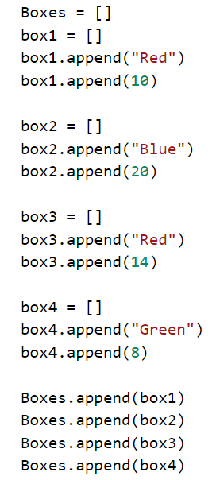
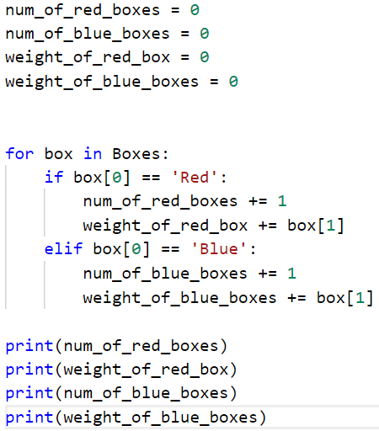
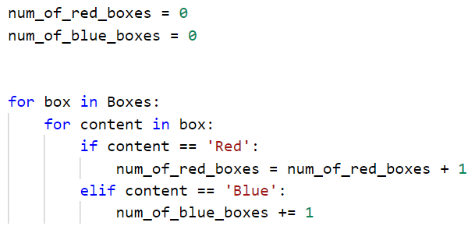
Data structure
Approach 1
Iteration Type 2
Iteration Type 1

Slide 27
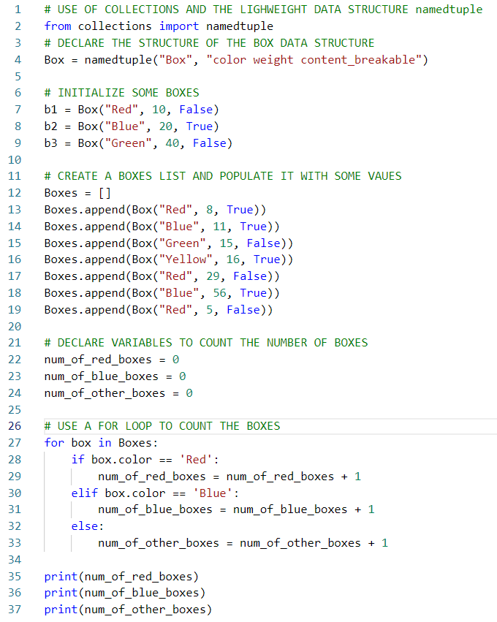
Approach 2
In this approach we use a special light weight data structure namedtuple provided by python collections.
We define the structure of the named tuples in line 4
We initialize the boxes and add them to the list called as Boxes in lines 7-20.
We define three variables to count the number of boxes stored in the list.
We use a for loop and conditionals to identify the boxes by color.
We finally print the number of boxes of different colors in lines 35-37.

